Slide 1


Smart India Hackathon 2024
Problem statement ID:
SIH 1550
Problem statement Title:
Development of portable device (non-contact device) for measurement of eye pressure in glaucoma patients for usage at home.
Theme:
MedTech / Bio Tech / HealthTech
Hardware
PS Category:
Hardware
Team ID:
36313
Team Name:
Aqueous

Slide 2

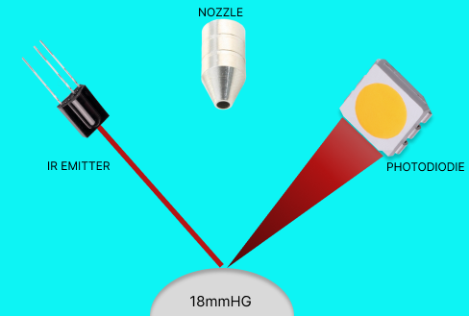
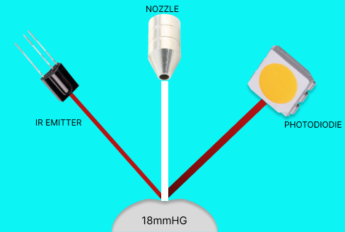
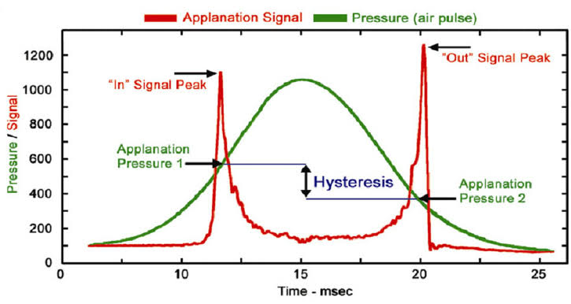
Tono_LITE
PROPOSED SOLUTION
Detailed Explanation :
Innovation and Uniqueness:
COST-EFFECTIVE , PORTABLE ,LIGHT WEIGHT, NON-CONTACT Device
Measures Intra ocular pressure (IOP) up to 50 mmHg Accurately , Reliably with safety
1. Central Corneal Thickness (CCT) factor applied output algorithm
2. Glaucoma identification using Low hysteresis value
Methods
3. Remote patient monitoring using IOT &DATA ANALYTICS
4. Components meets the Medical ISO ,IEC ,ANSI std
5. Device Final Price range 8k to 10k
Reflective property of cornea
Corneal hysteresis
6. Bernoulli’s theorem to maintain Constant pressure
How it Addresses the Problem :
7. Reliable and precise IOP even after Corneal Surgery
1.Even in low-cost ,it provides accurate results through ergonomic components
8.Weight of the final Product is 750g
2.Portable and Light weight because of Miniature components
9.Harmless significant Emitter 880nm
3.Non-contact due to Ocular response analyzer method
10.Optimized components for 50 mmHg

Slide 3
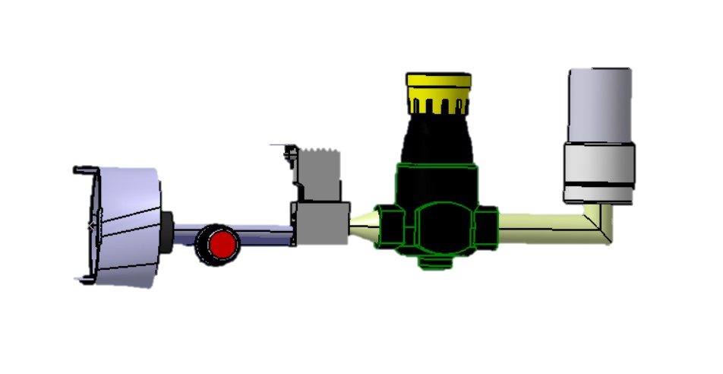
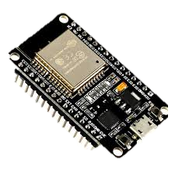


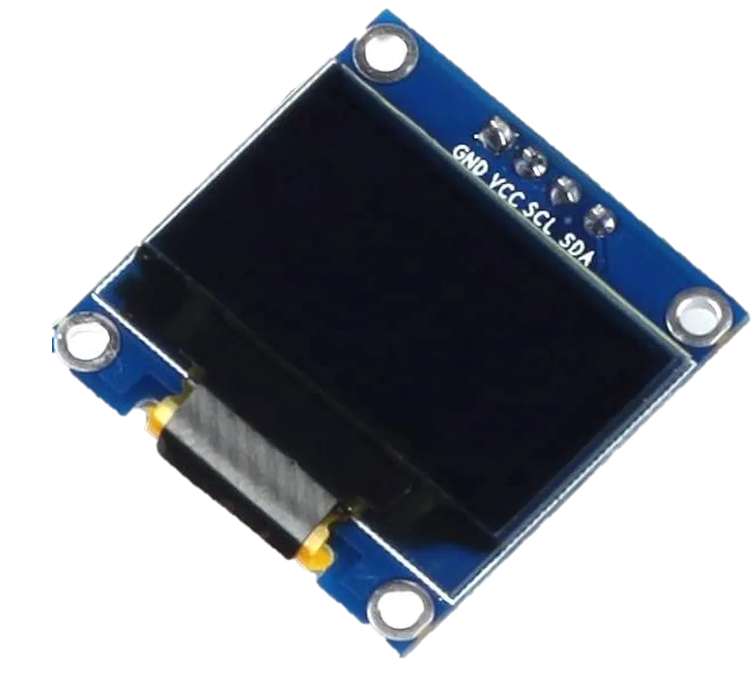
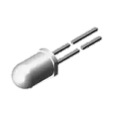

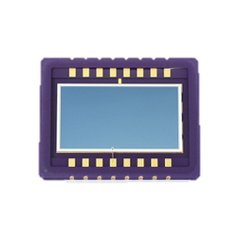


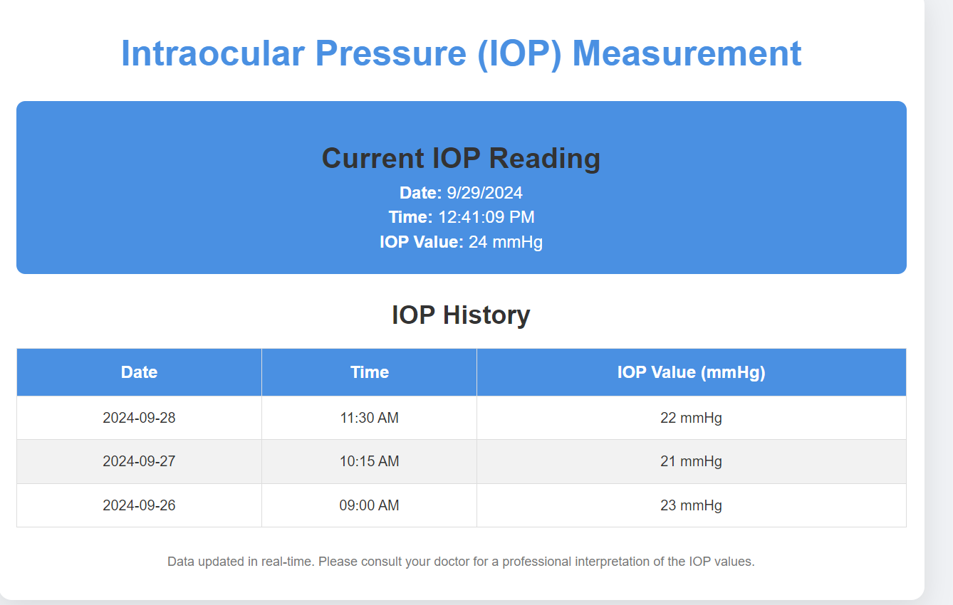
Technical Approach
Air-Puff Unit :
1.Air-Intaker
2.Pressure-Regulator
3.Solenoid-Valve
4.Round-Jet Nozzle
5.Connecting pipes
Controller Unit:
1.ESP 32 Wifi ,Bluetooth Development
2.Data Rate: 150Mbps
3.Frequency :2.4 GHz
Hardware
IOT
Display:
1.OLED module
2.Self Luminous
3.I2C protocol
Data on cloud
IR Unit:
1.Harmless Power IR Emitter (880nm)
2. Photo-Diode (700-1100nm)
Response in Nano Seconds.
Software
Dynamic Applanation Tonometry Algorithm +CCT +Corneal Hysteresis
Remote monitoring

Slide 4
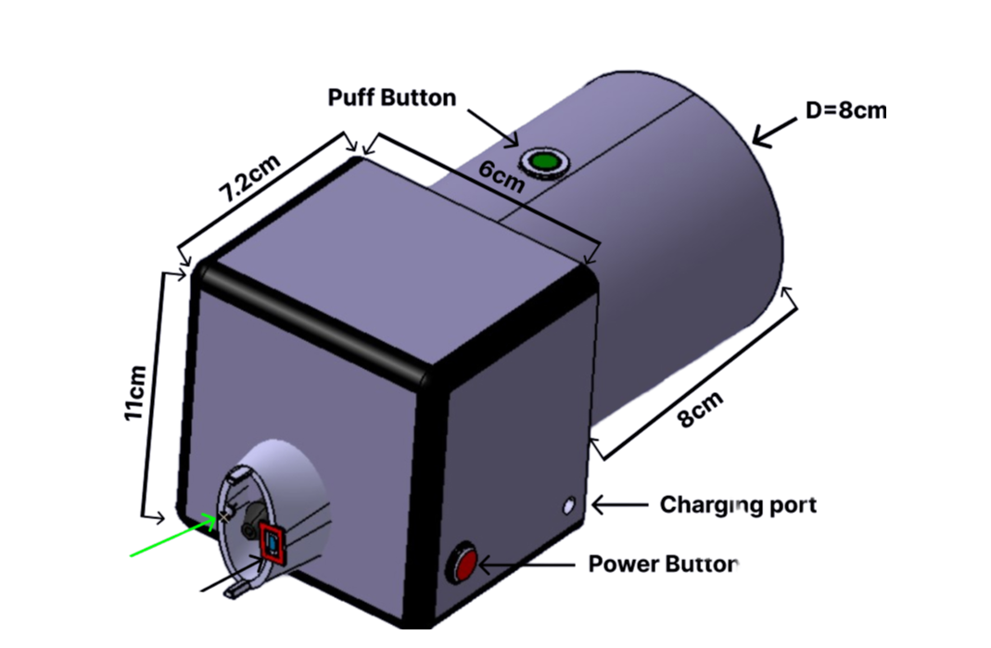
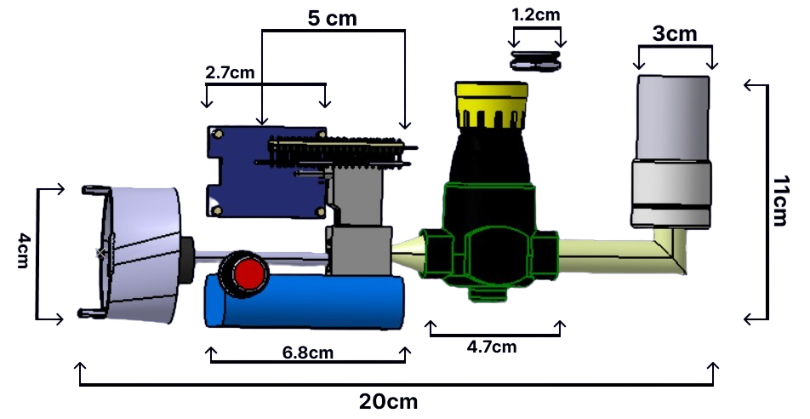

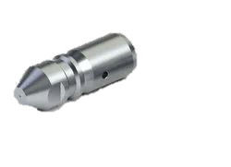
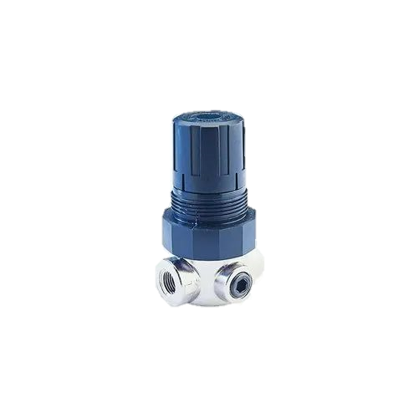
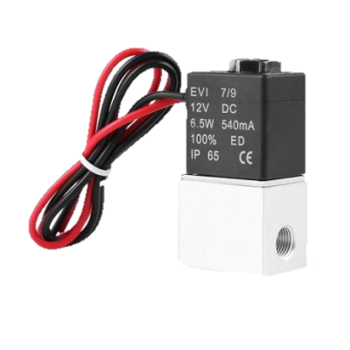

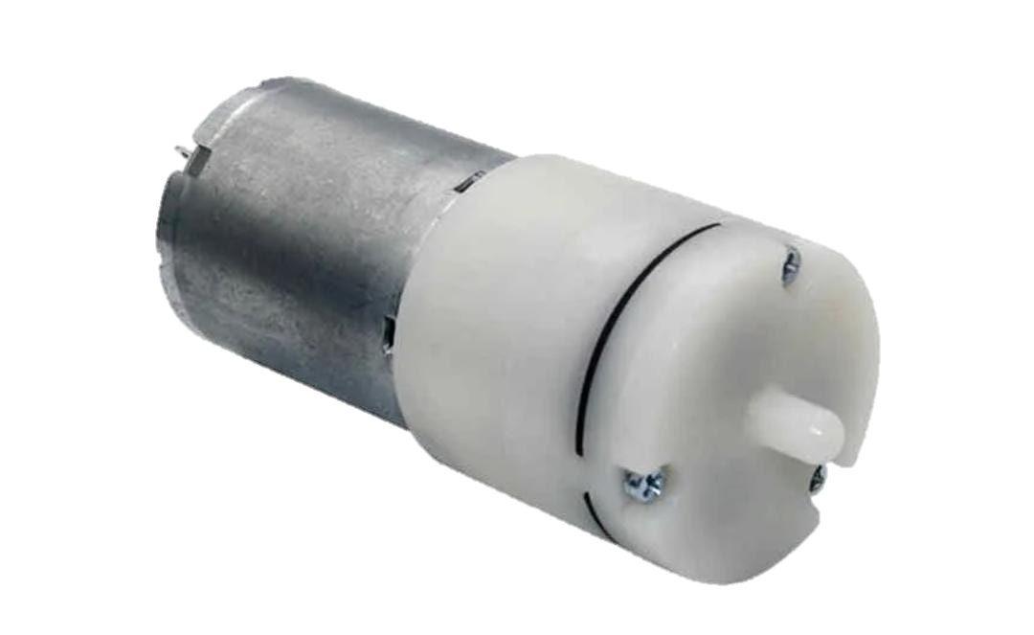
Methodology & Process for implementation
Flow Chart / Images
2
35 Degree Angle
IR Emitter
D= 30mm
photodiode
1
Inner-Schematic View
Outer-Schematic View
Working:
Based On The Applanation Rate And Corneal Hysteresis ,IOP And Glaucoma Will Be Monitored.
Air-Pump
Pressure-Regulator
Solenoid-Valve
Nozzle
Produces 600mmHg
Regulates to 55mmHg
Works as gate
Outputs 50mmHg

Slide 5
Feasibility & Viability
1. ANALYSIS OF THE CONCEPTUAL & TECHNICAL FEASIBILTY OF THE IDEA
Our Miniature Ocular Response Analyzer (TonoLite), measures the IOP by Corneal hysteresis and Central Corneal Thickness (CCT)
1.Air-Puff Unit :The Air-Pump ,Regulator ,Solenoid valve ,Nozzle effectively produces the amount of(50mmhg)
2. IR Unit :IR emitter and photodiode has high and large area of photosensitivity ,can reliably detect even small amount of reflection.
3. Controller and IOT: ESP32 module effectively perform all the above requirement.
So , The Miniature Ocular Response Analyzer is HIGHLY FEASIBLE AND POSSIBLE IN REAL-TIME
TR Level is 4
2. WHY THE IDEA IS VIABLE?
1.Cost Effective – very lower than current market products.
4.Strong market potential – medically highly impactful.
2.User Friendly – portable and easy operation.
5.Technical Scalability– accurate and low maintenance.
3.Medical standards – components satisfies ISO standards.
6.Overall viability score – 85% from Gen-AI
3. POTENTIAL CHALLENGES
Calibration Is The Highly Challenging ,By Testing And Simulation We Can Achieve The Good Calibration.
Regulatory compliance could slow down the market entry .

Slide 6
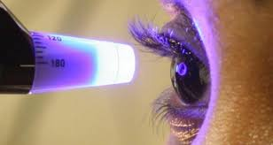

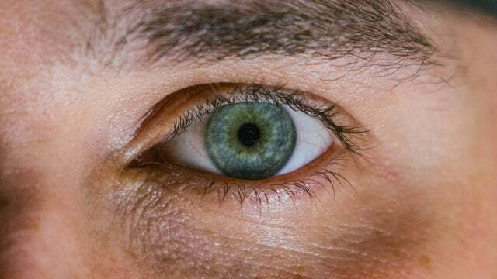


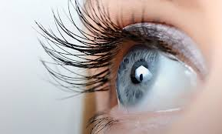
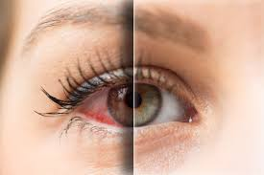
Impacts & Benefits
1. Potential Impact on Target Audience
Often IOP changes , need to be Diagnosed even outside of clinical settings
Existing ➔High Cost and Non-Portable and Contact Device
Glaucoma Patient
Diagnosing IOP
Generally 80 million people will be impacted around the world by this device
Helps patients proactively monitor their condition by using low cost and portable non-contact device, preventing disease progression through regular, at-home IOP checks.
Tono_LITE
Measures at 50 mmHg
2. Benefits of the Solution
Easy Accessibility
Preventative care
Low cost
Easy to use

Slide 7
Research and References
​Drive Link - Essential Documents,3D Model & Circuit of the Device
Glaucoma Risk factors and Progression
- 1. Glaucoma Risk factor (analysis)
Literature Review
- 1. iCare home2 ​ 2. Keeler Pulsair
IR Emitter in medical applications
- 1. Infrared Emitter
ANSI Z 136.1
- 1. ANSI
Photodiode
- 1. Absorbance measurements
Measurement of light Reflection
- 1. Photo Detection Measurement
IOP measurement
- 1. Measurement Method
Constant Air Pressure Maintenance
- 1. Bernoulli’s Principle

